Slide 1
Image Processing
CS460: COMPUTER GRAPHICS

Slide 2
Reading
The following links are available on the course homepage
http://www.dai.ed.ac.uk/HIPR2/noise.htm
http://www.dai.ed.ac.uk/HIPR2/mean.htm
http://www.cee.hw.ac.uk/hipr/html/median.html
http://homepages.inf.ed.ac.uk/rbf/HIPR2/gsmooth.htm

Slide 3
Definitions
Many graphics techniques operate only on images
Image processing: operations that take images as input, produce images as output
In its most general form, an image is a function f from R² to R
  f (x, y ) gives the intensity of a channel at position (x, y)
  defined over a rectangle, with a finite range:
  f : [a,b]x[c,d] [0,1]
  A color image is just three functions pasted together:
    f ( x, y ) = (f_{r}(x, y ), f_{g}( x, y ), f_{b}( x, y ))
- You can check the RGB value of each pixel in MS Paint

Slide 4

Images
In computer graphics, we usually operate on digital (discrete) images
  Quantize space into units (pixels)
  A kind of step function
  f : {0 … m -1}x{0 … n -1} [0,1]
An image processing operation typically defines an image f ’ in terms of an existing image f

Slide 5
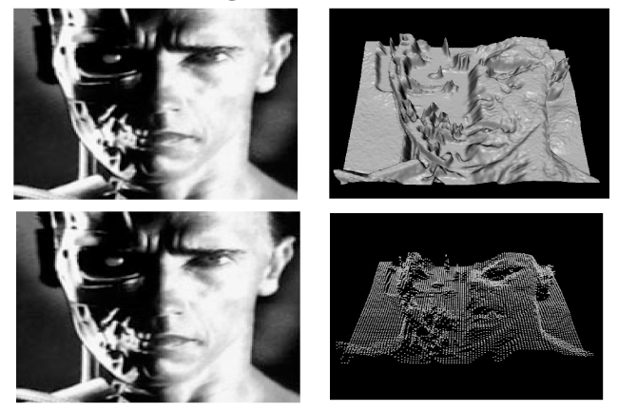
Images as Functions

Slide 6
Pixel-to-pixel Operation
The simplest operations are those that transform each pixel in isolation
f ’ (x, y ) = g (f (x,y))
Example: thresholding
f (x,y)
f ‘ (x,y)
.4 .3 .2 .1
.3 .8 .9 .2
.2 .5 .7 .3
.1 .0 .2 .4
.0 .0 .0 .0
.0 .8 .9 .0
.0 .5 .7 .0
.0 .0 .0 .0
If pixel_value < .5, pixel_value = .0

Slide 7
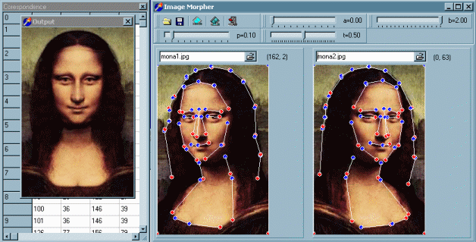
Pixel Movement
Some operations preserve intensities, but move around in the image
f ’ ( x, y ) = f (g(x,y), h(x,y))
i.e. Output Image's Pixel = Input Image's Pixel at a different location (given by g(x,y), h(x,y))
Examples: many amusing warps of images

Slide 8
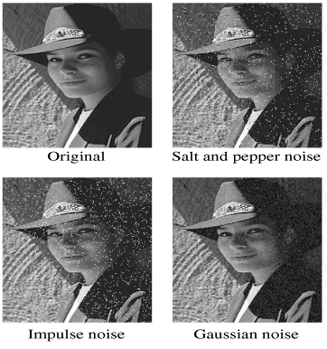
Noise
Common types of noise

Slide 9
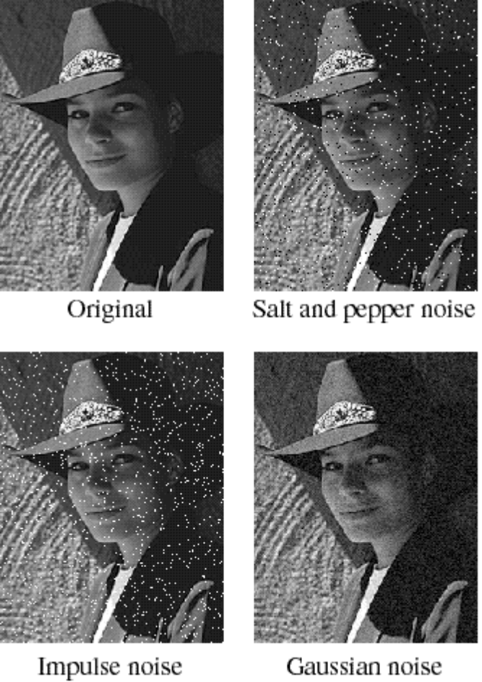
Noise
Common types of noise:
  Salt and pepper noise: random black and white pixels
  Impulse noise: random white pixels
  Gaussian noise: variations in intensity drawn from a Gaussian (normal) distribution

Slide 10
Noise Reduction
Is there a way to “smooth” out the noise?

Slide 11

Reducing Noise
0
0
0
0
0
0
0
0
0
0
0
0
0
0
0
0
0
0
0
0
0
0
0
90
90
90
90
90
0
0
0
0
0
90
90
90
90
90
0
0
0
0
0
90
90
90
90
90
0
0
0
0
0
90
0
90
90
90
0
0
0
0
0
90
90
90
90
90
0
0
0
0
0
0
0
0
0
0
0
0
0
0
90
0
0
0
0
0
0
0
0
0
0
0
0
0
0
0
0
0
Filtering
  look at the neighborhood N around each pixel
  replace each pixel with new value as a function of pixels in N
  The behavior of a filter depends on N and f

Slide 12


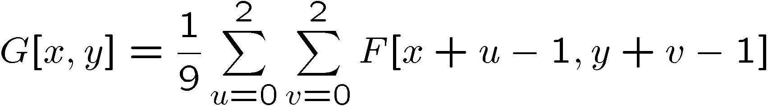
Mean filtering
0
0
0
0
0
0
0
0
0
0
0
0
0
0
0
0
0
0
0
0
0
0
0
90
90
90
90
90
0
0
0
0
0
90
90
90
90
90
0
0
0
0
0
90
90
90
90
90
0
0
0
0
0
90
0
90
90
90
0
0
0
0
0
90
90
90
90
90
0
0
0
0
0
0
0
0
0
0
0
0
0
0
90
0
0
0
0
0
0
0
0
0
0
0
0
0
0
0
0
0
Replace each pixel with an average of the pixels in the k×k box around it
  3×3 case:

Slide 13
Mean filtering
0
0
0
0
0
0
0
0
0
0
0
0
0
0
0
0
0
0
0
0
0
10
20
30
30
30
20
10
0
0
0
90
90
90
90
90
0
0
0
20
40
60
60
60
40
20
0
0
0
90
90
90
90
90
0
0
0
30
60
90
90
90
60
30
0
0
0
90
90
90
90
90
0
0
0
30
50
80
80
90
60
30
0
0
0
90
0
90
90
90
0
0
0
30
50
80
80
90
60
30
0
0
0
90
90
90
90
90
0
0
0
20
30
50
50
60
40
20
0
0
0
0
0
0
0
0
0
0
10
20
30
30
30
30
20
10
0
0
90
0
0
0
0
0
0
0
10
10
10
0
0
0
0
0
0
0
0
0
0
0
0
0
0
0
Replace each pixel with an average of the pixels in the k×k box around it
  3×3 case:

Slide 14
What about border pixels?
0
0
0
0
0
0
0
0
0
0
0
0
0
0
0
0
0
0
0
0
0
10
20
30
30
30
20
10
0
0
0
90
90
90
90
90
0
0
0
20
40
60
60
60
40
20
0
0
0
90
90
90
90
90
0
0
0
30
60
90
90
90
60
30
0
0
0
90
90
90
90
90
0
0
0
30
50
80
80
90
60
30
0
0
0
90
0
90
90
90
0
0
0
30
50
80
80
90
60
30
0
0
0
90
90
90
90
90
0
0
0
20
30
50
50
60
40
20
0
0
0
0
0
0
0
0
0
0
10
20
30
30
30
30
20
10
0
0
90
0
0
0
0
0
0
0
10
10
10
0
0
0
0
0
0
0
0
0
0
0
0
0
0
0
Some options
  don’t evaluate—image gets smaller each time a filter is applied
  pad the image with more rows and columns on the top, bottom, left, and right
    option 1: copy the border pixels: add [0 0 0] to F in above case
    option 2: reflect the image about the border: add [0 90 0] to F in above case

Slide 15
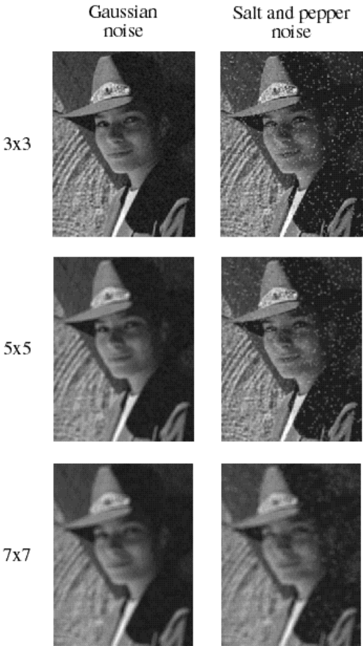
Effect of filter size
What happens if we
use a larger mean filter?
5×5? 7×7?

Slide 16


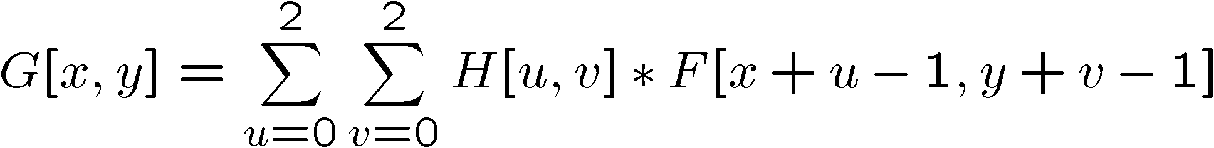
Weighted average filtering
0
0
0
0
0
0
0
0
0
0
0
0
0
0
0
0
0
0
0
0
0
0
0
90
90
90
90
90
0
0
0
0
0
90
90
90
90
90
0
0
1
1
1
0
0
0
90
90
90
90
90
0
0
1
1
1
0
0
0
90
0
90
90
90
0
0
1
1
1
0
0
0
90
90
90
90
90
0
0
0
0
0
0
0
0
0
0
0
0
0
0
90
0
0
0
0
0
0
0
0
0
0
0
0
0
0
0
0
0
Replace each pixel with a weighted average of the pixels in the k×k box
  3×3 case:

Slide 17

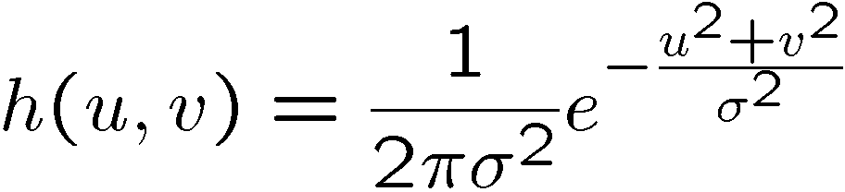
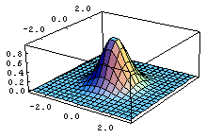
Gaussian filter
0
0
0
0
0
0
0
0
0
0
0
0
0
0
0
0
0
0
0
0
0
0
0
90
90
90
90
90
0
0
0
0
0
90
90
90
90
90
0
0
1
2
1
0
0
0
90
90
90
90
90
0
0
2
4
2
0
0
0
90
0
90
90
90
0
0
1
2
1
0
0
0
90
90
90
90
90
0
0
0
0
0
0
0
0
0
0
0
0
0
0
90
0
0
0
0
0
0
0
0
0
0
0
0
0
0
0
0
0
This filter H is a good approximation to
Properties of Gaussian
  more weight to the center
  good model of blurring in optical systems
  σ corresponds to width of the Gaussian

Slide 18
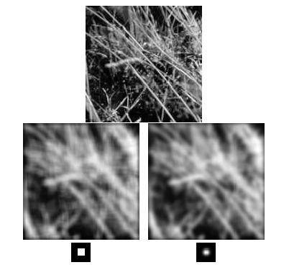
Comparison of mean vs. gaussian filter

Slide 19


Convolution
Convolution is a fancy way to combine two functions.
  Think of f as an image and g as a “smear” operator
  g determines a new intensity at each point (pixel) in terms of intensities at the neighborhood of that point (pixel)

Slide 20
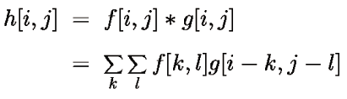
Discrete Convolution
For digital images, integration becomes summation. We can express convolution as a two-dimensional sum:

Slide 21
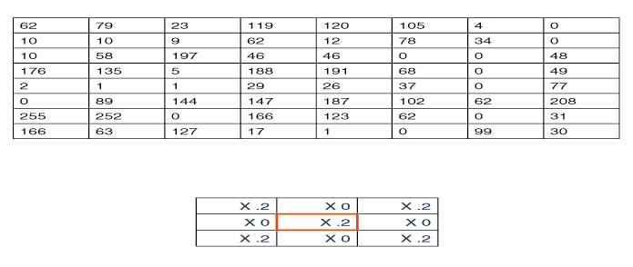
Convolution Representation
Since f and g are defined over finite regions, we can write them out in two-dimensional arrays, e.g.
f :
g:

Slide 22
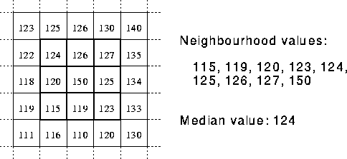
Median Filter
A Median Filter operates over a kxk region by selecting the median intensity in the region.
  What advantage does a median filter have over a mean filter?
  Robust to noise!

Slide 23
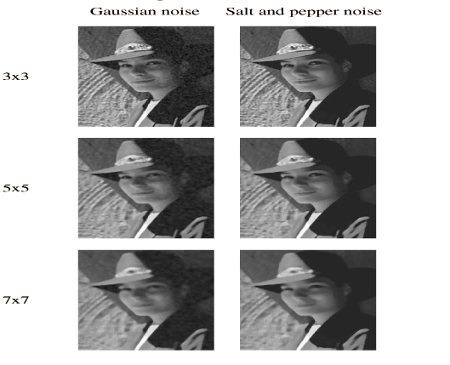
Using Median Filters

Slide 24
Edge Detection
One of the most important uses of image processing is edge detection
  Really easy for humans
  Really difficult for computers
  Fundamental in computer vision
  Important in many graphics applications
What defines an edge?
step
ramp
line
roof

Slide 25
Edge Detection
Edge detection algorithms typically proceed in four steps:
  Filtering: cut down on noise
  Enhancement: amplify the difference between edges and non-edges
  Detection: use a threshold operation
  Localization (optional): estimate geometry of edges beyond pixels

Slide 26

Gradient
The gradient is the 2D equivalent of the derivative:
Properties of the gradient
  It’s a vector
  Points in the direction of maximum increase of f
  (direction of the steepest descent)
  Magnitude is rate of increase
How can we approximate the gradient in a discrete image?

Slide 27
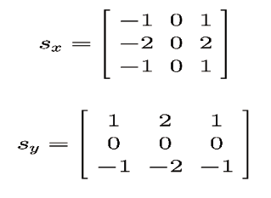
Edge Enhancement
A popular gradient magnitude computation is the Sobel operator:
We can then compute the magnitude of the vector (G_{x},G_{y})^{T}

Slide 28
Sobel Operator: Example
1 1 1 1 1 0 0 0 0 0
1 1 1 1 1 0 0 0 0 0
1 1 1 1 1 0 0 0 0 0
1 1 1 1 1 0 0 0 0 0
1 1 1 1 1 0 0 0 0 0
1 1 1 1 1 0 0 0 0 0
1 0 0
1 0 0
1 0 0
-1 0 1
-2 0 2
-1 0 1
G_{x} =
*
= -4
G_{y} =
1 0 0
1 0 0
1 0 0
1 2 1
0 0 0
-1 -2 -1
= 0
*
(G_{x},G_{y})^{T} = (-4,0)^{T}

Slide 29
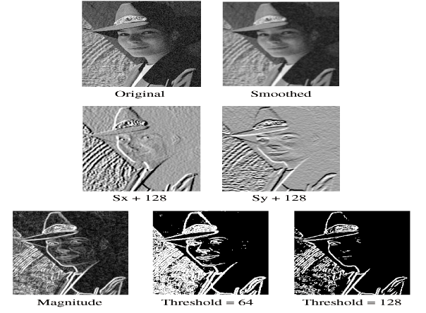
Using Sobel Operators
G_{x} + 128
G_{y} + 128

Slide 30
Summary
What you should take from this lecture:
Formal definitions of image and image processing
Kinds of image processing: pixel-to-pixel, movement, convolution, others
Types of noise and strategies for noise reduction
Definition of convolution and how discrete convolution works
The effects of mean, median and Gaussian filtering
How edge detection is done
Gradients and discrete approximations
Read the materials in “Extras” listed in the lecture webpage to see more examples

